Slide 1
How Does Universal Health Coverage work?

Slide 2
UNIVERSAL HEALTH COVERAGE
The united state does not have universal health Insurance coverage. Nearly 92 percent of the population was estimated to be insurance in 2018. Movement of increment in healthcare has increased.
Employee-Sponsored health insurance was introduced during 1920. But gain popularity after World War II after government implement wage control and declared fringe benefit such as health insurance . According to 2018 survey , 55% of population was covered under employee insurance.
In 1965 , the first public Insurance program Medicare and Medicaid, were enacted through the social security Act .

Slide 3
MEDICARE
Medicare ensure a right to health care for person aged 65 and older. Eligible population and the range of benefit has expanded. In 1972 individual with younger that 65 with long term diseases and end stage diseases became eligible for Medicare.
All the payees are entitled to traditional Medicare, a fee-for-service program that provides hospital that provides hospital insurance (Part A) ,medical insurance (Part B), Medicare or Medicare Advantage (Part C), under which people enroll in a private health-maintained organization(HMO) or managed care organization . Part D was added on 2003, a voluntary outpatient prescription drug coverage option provided through private carriers.

Slide 4
MEDICAID
Medicaid was funded for providing health care service to low-income families.
Today , Medicaid covers 17.9 percent of American.
Notes:
As it state-administered, mean tested program , eligibility criteria vary by state. Individual need to apply for Medicaid coverage and need to re enroll and recertify annually.
As of 2019, more than third-third of Medicaid beneficiaries were enrolled in managed
care Organization.

Slide 5
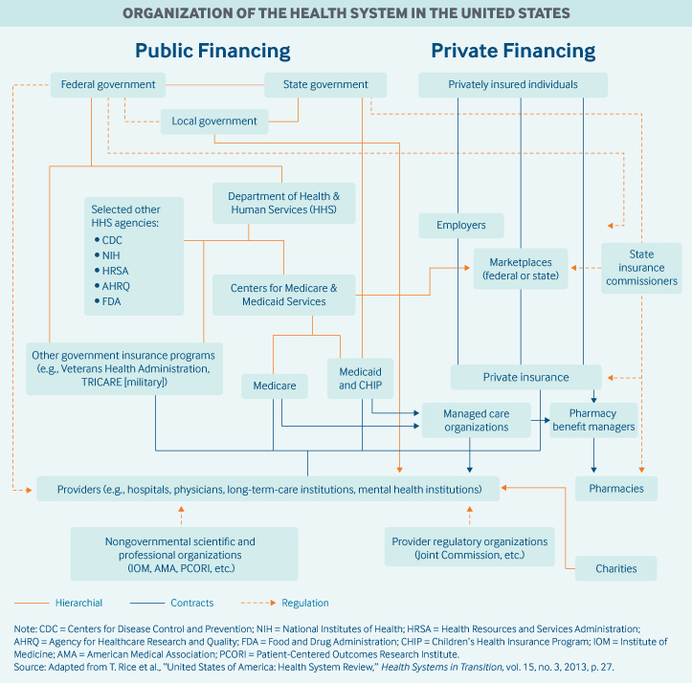

Slide 6
ROLE OF PUBLIC HEALTH INSURANCE
In 2017,public spending accounted for 45 percent of total health care spending , or approximately 8 percent of GDP.
The center of Medicare and Medicaid Service is the largest government source of health coverage funding.
Medicare is funded through combination of general federal tax, a mandatory pay roll tax that pay part A (hospital insurance) and individual premiums.
Medicaid is largely tax-funded, with federal tax revenues representing two-third (63%) of costs.
Notes:
The expansion of Medicaid under the ACA was fully funded by the federal government until 2017, after which the federal funding share gradually decreased to 90%%.

Slide 7
ROLE OF HEALTH INSURANCE
Most employers contract with private health plans to administer benefits. Most employer plans cover workers and their dependents, and the majority offer a choice of several plans.^{8,9} Both employers and employees typically contribute to premiums; much less frequently, premiums are fully covered by the employer
Notes:
Spending on private health insurance accounted for one-third (34%) of total health expenditures in 2018. Private insurance is the primary health coverage for two-thirds of Americans (67%). The majority of private insurance (55%) is employer-sponsored, and a smaller share (11%) is purchased by individuals from for-profit and nonprofit carriers.

Slide 8
HOW IS THE DELIVERY SYSTEM ORGANIZED AND HOW ARE PROVIDERS PAID?

Slide 9
PHYSICIAN EDUCATION AND WORKFORCE
Most medical schools (59%) are public. Median tuition fees in 2019 were $39,153 in public medical schools and $62,529 in private schools. Most student (73%) graduate with medical debt averaging $200,000 (2019), an amount that the includes

